Slide 1
Smart Alarm System
TEAM MEMBERS:
Nurlan NogiBaev, Abdul Hakim, and Jahanzaib danish

Slide 2
contents
Introduction
Target Audience
Methodology and resources need/used
Project completion

Slide 3
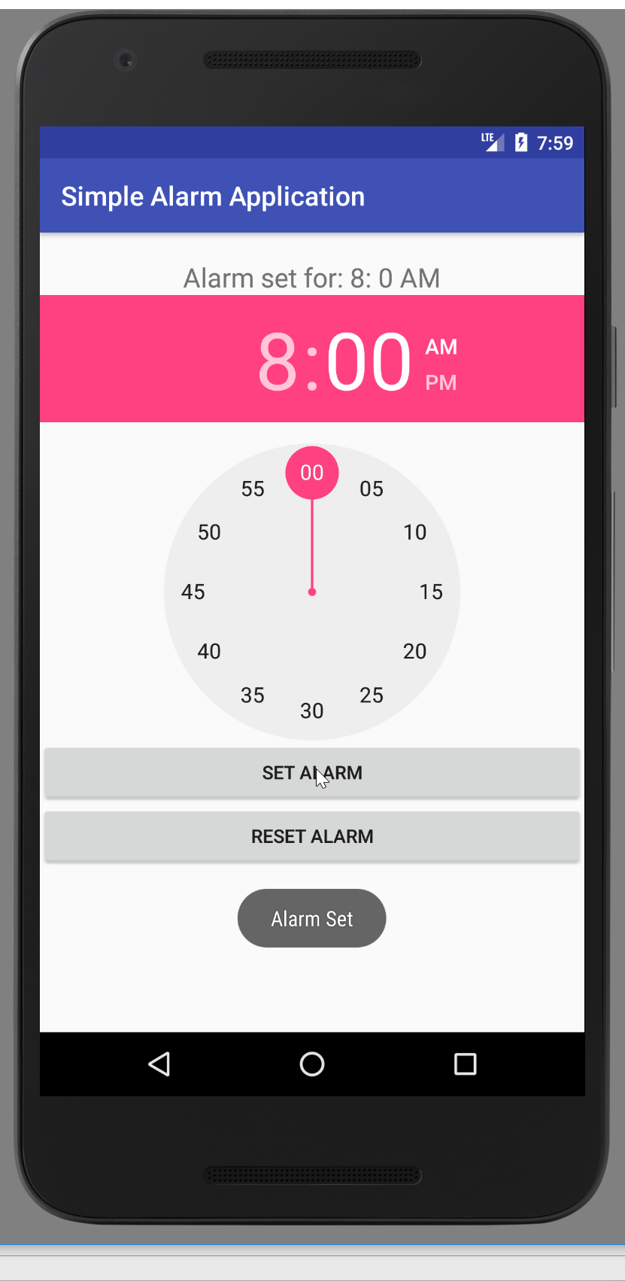
Introduction
Alarm are used to alert an individual or group of individuals at a specified time.
Android based alarm system which will work in the following steps
User will set a remainder
Once time approaches, the buzzer will start
Upon clicking on stop button, camera will open
Will ask the user to take picture of random things (toothbrush, toilet seat, water basin etc.) use in the morning
Will recognize the image and alarm will stop

Slide 4

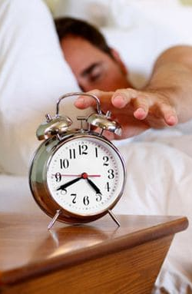




Target Audience
Usually people find it hard to get off the bed in the morning
Just close/stop the alarm and then got to sleep again
Our app will force them to get off the bed to stop the alarm
People struggling to get off the bed especially in the morning

Slide 5

Methodology and Resources
User signup, keep track of sleeping behavior and no of users
Simple interface for users to set the alarm
Need the Camera API to open the camera once user hit stop button
We will use Firebase ML kit to object detection purpose
Will use firebase data base to store the credentials of users
Will pick some things we use in the morning and the app will ask the user to take picture of any random object from it
Once the asked object is detected the alarm will stop

Slide 6
Project completion
Will test in emulators and android phone
Ask UCA students to install and use it
Improve it based on feedbacks

Slide 7
The End! Any questions?

